Slide 1
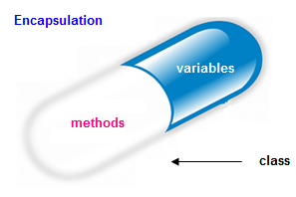



Модификатори за достъп
Видимост на членовете на клас
Увод в ООП
Учителски екип
Обучение за ИТ кариера
https://it-kariera.mon.bg/e-learning/

Slide 2

Съдържание
Какво представляват модификаторите за достъп
Private
Public
Protected
Internal

Slide 3
Private Модификатор за достъп
Основен начин за капсулиране на обект и скриване на данни от външния свят
Класовете и интерфейсите не могат да са private. Идеята за интерфейс е да се даде възможност за връзка с „външния свят“ – т.е. – трябва да са достъпни
Могат да бъдат достъпни само в декларацията на класа
private string name;
Person (string name)
{
this.name = name;
}
Notes:
Access Level "public"
When we use the modifier public in front of some element, we are telling the compiler, that this element can be accessed from every class, no matter from the current project (assembly), from the current package. The access level public defines the miss of restrictions regarding the visibility. This access level is the least restricted access level in Java.
Access Level "private"
The access level private is the one, which defines the most restrictive level of visibility of the class and its elements. The modifier private is used to indicate, that the element, to which is issued, cannot be accessed from any other class (except the class, in which it is defined), even if this class exists in the same package.
Access Level “protected"
The access level private is the one, which defines the most restrictive level of visibility of the class and its elements. The modifier private is used to indicate, that the element, to which is issued, cannot be accessed from any other class (except the class, in which it is defined), even if this class exists in the same namespace.
Access Level “default"
This is the default access level, i.e. it is used when there is no access level modifier in front of the respective element of a class. Members can be accessed only from the same package.

Slide 4
Protected Модификатор за достъп
Могат да бъдат достъпни само от подкласове
Модификаторът за достъп Protected не може да бъде приложен за класове и интерфейси
Предотвратява външни класове да се опитват да го използват
class Person
{
protected string FullName { get; set; }
}
Notes:
Access Level "public"
When we use the modifier public in front of some element, we are telling the compiler, that this element can be accessed from every class, no matter from the current project (assembly), from the current package. The access level public defines the miss of restrictions regarding the visibility. This access level is the least restricted access level in Java.
Access Level "private"
The access level private is the one, which defines the most restrictive level of visibility of the class and its elements. The modifier private is used to indicate, that the element, to which is issued, cannot be accessed from any other class (except the class, in which it is defined), even if this class exists in the same package.
Access Level “protected"
The access level private is the one, which defines the most restrictive level of visibility of the class and its elements. The modifier private is used to indicate, that the element, to which is issued, cannot be accessed from any other class (except the class, in which it is defined), even if this class exists in the same namespace.
Access Level “default"
This is the default access level, i.e. it is used when there is no access level modifier in front of the respective element of a class. Members can be accessed only from the same package.

Slide 5
Internal модификатор за достъп
Internal е модификатор по подразбиране в C#
Дава достъп на всеки друг клас в същия проект
class Person
{
string Name { get; set; }
internal int Age { get; set; }
}
Team rm = new Team("Real");
rm.Name("Real Madrid");
Notes:
Access Level "public"
When we use the modifier public in front of some element, we are telling the compiler, that this element can be accessed from every class, no matter from the current project (assembly), from the current package. The access level public defines the miss of restrictions regarding the visibility. This access level is the least restricted access level in Java.
Access Level "private"
The access level private is the one, which defines the most restrictive level of visibility of the class and its elements. The modifier private is used to indicate, that the element, to which is issued, cannot be accessed from any other class (except the class, in which it is defined), even if this class exists in the same package.
Access Level “protected"
The access level private is the one, which defines the most restrictive level of visibility of the class and its elements. The modifier private is used to indicate, that the element, to which is issued, cannot be accessed from any other class (except the class, in which it is defined), even if this class exists in the same namespace.
Access Level “default"
This is the default access level, i.e. it is used when there is no access level modifier in front of the respective element of a class. Members can be accessed only from the same package.

Slide 6
Public модификатор за достъп
Клас, метод, конструктор, деклариран в public клас може да бъде достъпен от всеки клас, принадлежащ на .NET света
Употребата се налага ако се опитваме да достъпим public клас в друг namespace
Методът main() в приложението трябва да е public
Интерфейсите са public. Тъй като смисълът им е да дават връзка с външния свят
public class Person
{
public string Name { get; set; }
public int Age { get; set; }
}
Notes:
Access Level "public"
When we use the modifier public in front of some element, we are telling the compiler, that this element can be accessed from every class, no matter from the current project (assembly), from the current package. The access level public defines the miss of restrictions regarding the visibility. This access level is the least restricted access level in Java.
Access Level "private"
The access level private is the one, which defines the most restrictive level of visibility of the class and its elements. The modifier private is used to indicate, that the element, to which is issued, cannot be accessed from any other class (except the class, in which it is defined), even if this class exists in the same package.
Access Level “protected"
The access level private is the one, which defines the most restrictive level of visibility of the class and its elements. The modifier private is used to indicate, that the element, to which is issued, cannot be accessed from any other class (except the class, in which it is defined), even if this class exists in the same namespace.
Access Level “default"
This is the default access level, i.e. it is used when there is no access level modifier in front of the respective element of a class. Members can be accessed only from the same package.

Slide 7
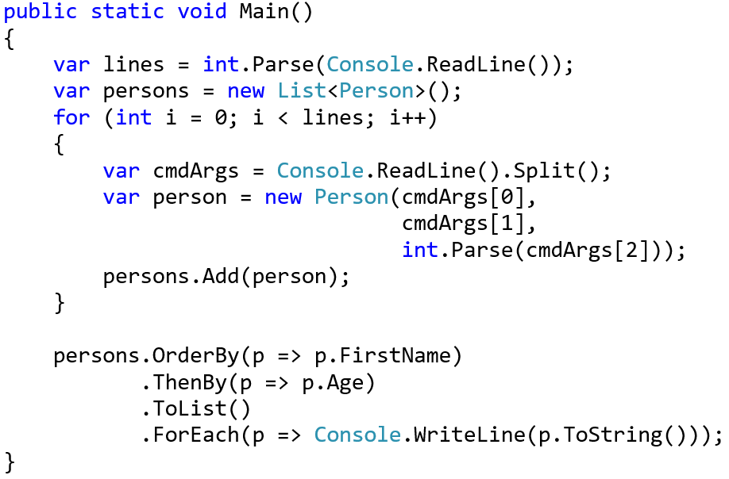
Задача: Подредете Persons по Name и Age
Създайте клас Person
Person
-firstName:string
-lastName:string
-age:int
+FirstName():string
+Age():int
+toString():string

Slide 8
Задача: Подредете Persons по Name и Age
public class Person {
private string firstName;
private string lastName;
private int age;
public string FirstName => return this.firstName;
public int Age => return this.lastName;
public override string ToString()
{
\\TODO: Add logic
}
}

Slide 9
Задача: Увеличение на заплатата
Добавете към Person salary
Добавете getter за заплата
Добавете метод, който променя заплатата с даден процент
Persons, по-млади от 30 вземат половината от увеличението
Person
-firstName : string
-lastName : string
-age : int
-salary : double
+FirstName: string
+Age: int
+Salary: double
+IncreaseSalary(int):void
+ToString(): string

Slide 10
Решение: Getters and Setters
Разширяваме Person от предишната задача
private double salary;
public void IncreaseSalary(double percent)
{
if (this.age > 30)
this.salary += this.salary * percent / 100;
else
this.salary += this.salary * percent / 200;
}

Slide 11




Обобщение
Модификаторите определят степента на капсулация на данните
Private - за полета
Protected – за насленици (подкласове)
Internal – за класове от същия проект (namespace)
Public – за класове и интерфейси в целия .Net

Slide 12
Модификатори за достъп
https://it-kariera.mon.bg/e-learning/

Slide 13




Министерство на образованието и науката (МОН)
Настоящият курс (презентации, примери, задачи, упражнения и др.) е разработен за нуждите на Национална програма "Обучение за ИТ кариера" на МОН за подготовка по професия "Приложен програмист"
Курсът е базиран на учебно съдържание и методика, предоставени от фондация "Софтуерен университет" и се разпространява под свободен лиценз CC-BY-NC-SA

